Slide 1

PROJECT NAME
SMART AGRICULTURAL ROBOT
PRESENTED BY -
1.CHAITANYA SOMANI (192132137211)
2. VAISHNAVI GHUGE (1921321372120)
3. SAURABH JAGDAMBE (1921321372124)
GUIDED BY – DR S. N. PAWAR SIR

Slide 2
CONTENT
ABSTRACT
INTRODUCTION
LITERATURE SURVEY
BLOCK DIAGRAM
COMPONENTS
MERIT & DEMERIT
FUTURE SCOPE
CONCLUSIONS

Slide 3
ABSTRACT
The aims of the design, development and the fabrication of the robot which can dig the soil, put the seeds, leveler to close the mud and sprayer to spray water, these whole systems of the robot works with the battery and the solar power.
More than 40% of the population in the world chooses agriculture as the primary occupation, in recent years the development of the autonomous vehicles in the agriculture has experienced increased interest.
The advantages of these robots are hands-free and fast data input operations.

Slide 4
INTRODUCTION
The growth or development of any nation within the world is completely depends up on the agriculture production. If proper machinery is employed during this field, accuracy in the forming and quality within the production will be achieved.
Traditional methods of sowing seeds manually and other activities like ploughing, water pouring, pesticide spraying, etc are done manually that consume lot of your time and it should not be accurate due to human errors.
Therefore here a 4 in-one machine is intended for doing above jobs automatically. With the help of controlled unit designed with android mobile, entire machine movements will be controlled through its wifi interface and therefore the one who is working this machine need not to urge into the sector.

Slide 5
LITERATURE SURVEY
In the current scenario most of us have come across the atomization in various fields as the advancement of technology has to a lead tremendous development in the industrial products that have made our lives a lot easier and helpful than what our ancestors faced.
A Survey on “AGRICULTURAL ROBOT” strives to develop a robot capable of performing operations like automatic ploughing, seed dispensing. It also provides manual control.
“Agricultural Robot for Automatic Ploughing and Seeding” 2015 IEEE International Conference on Technological Innovations in ICT. (Amrita Sneha.A, Ankita.A, Mrs. R. Praveen, ) has proposed survey in 2015.

Slide 6
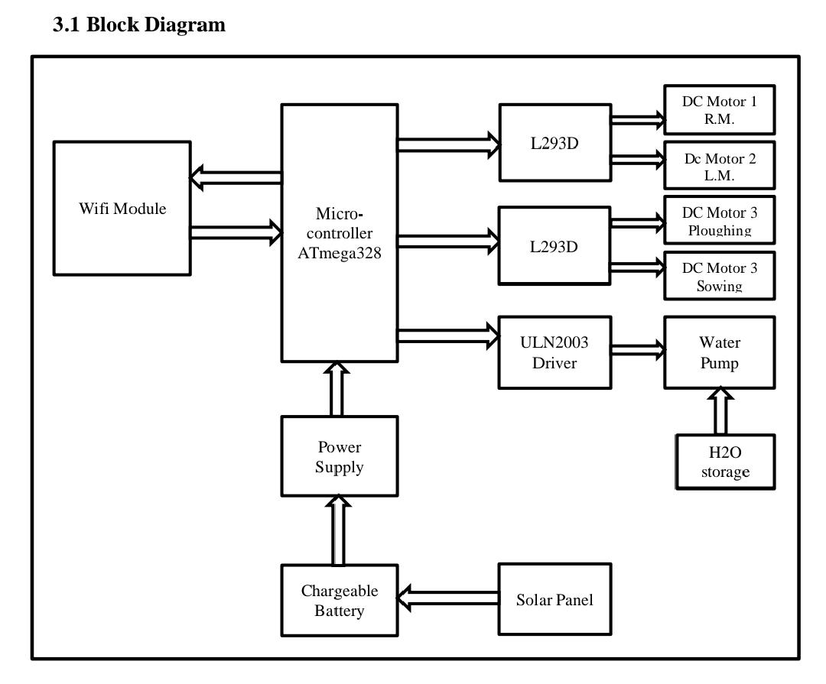
BLOCK DIAGRAM
.

Slide 7
COMPONENTS
Arduino
Solar panel
ATmega328
DC motor
Cables and Connectors
Battery
wifi module(ESP8266)

Slide 8
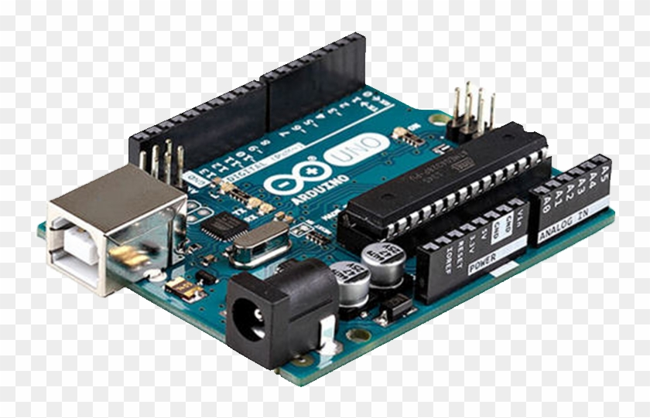
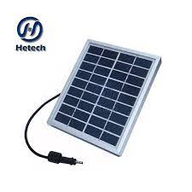
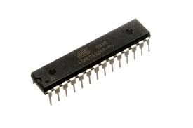
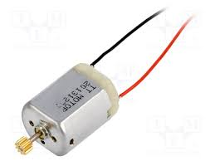
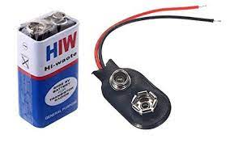
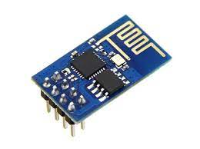
COMPONENTS

Slide 9
MERIT
Increased labour efficiency and decreased cost.
(Minimum use of labours).
Increased financial sustainability.
It allows farmers to maximize yields using minimum resources such as water, fertilizers, seeds etc
Decreases the time Consumption as compare to labour work.
Works More precisely than the labours.

Slide 10
DEMERITS
Agricultural robots and other equipments are complex and requires training to be provided to farmers before use.
They need maintenance to keep them running.
The labours can lose their jobs.

Slide 11
FUTURE SCOPE
Our farm equipment companies and researchers have developed a lot of small and heavy farm equipment for traditional farming needs but some kind of robotic and are required in precision farming.
If the robots are being used for weed control, that will help to reduce the herbicides usage and the produces will turn into an organic, the same way robots can be used for transplanting the seedlings to avoid intensive labor.
If we think advanced intelligent machines in farming, Sensors or readers and hand held PDAs are going to be great helpful in computation and accuracy in farming

Slide 12
CONCLUSION
In agriculture, by using the solar operated multi-purpose agriculture robot. We can easily reduce the man power, farming tools and time.
The machine required less farmers and less time compared to the old working methods.
Keeping all this valuable limitation and benefits in mind our multipurpose agriculture robot works on 4 in one operation and given commands.
We hope this will satisfy the needs of Indian agriculture and hard working farmers. In this way we can overcome the labour problem that is required of today’s farming in India.

Slide 13
THANK YOU !

